Slide 1

Real Estate project
Chirag Bansal
2010991525
Group G22

Slide 2


Functionalities
Login / Signup
News
Predict trends
Post Property
Book Property
Broker Details

Slide 3
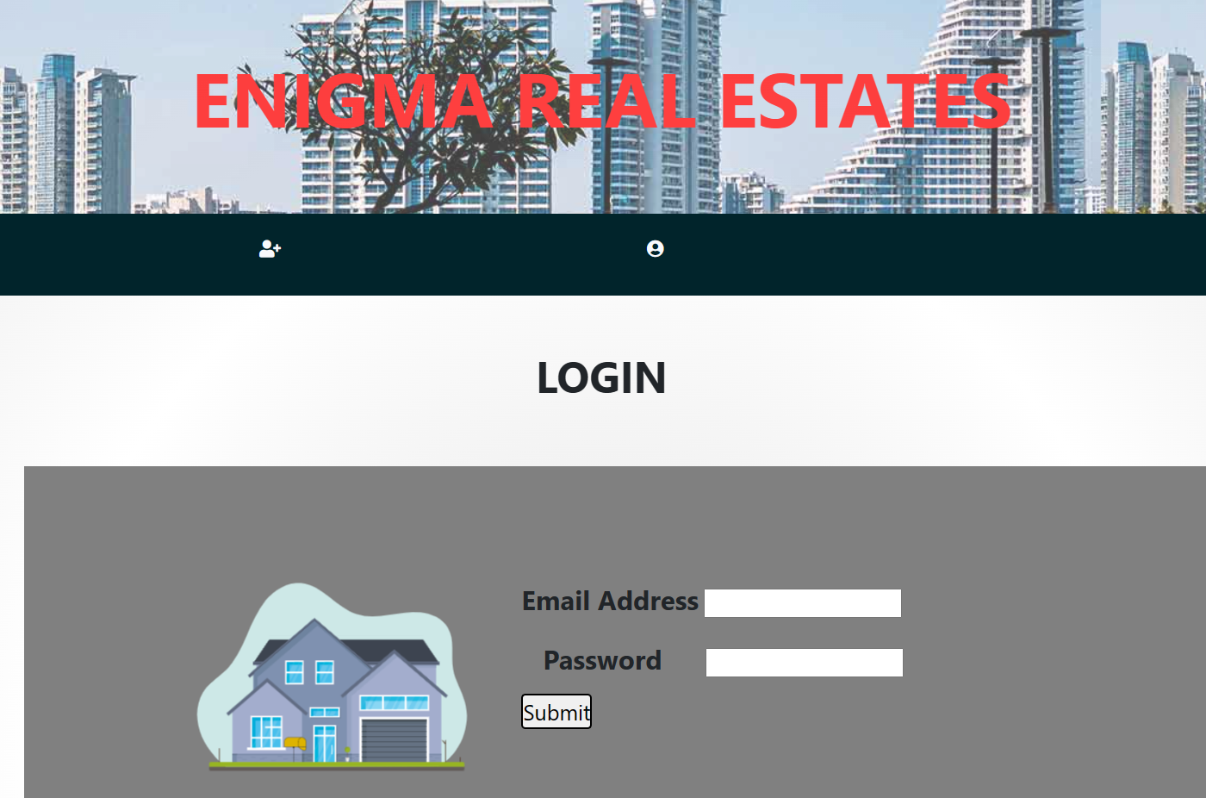
Login Page
The project starts with a prompt to which asks the user to login by entering his/her correct email address and password

Slide 4
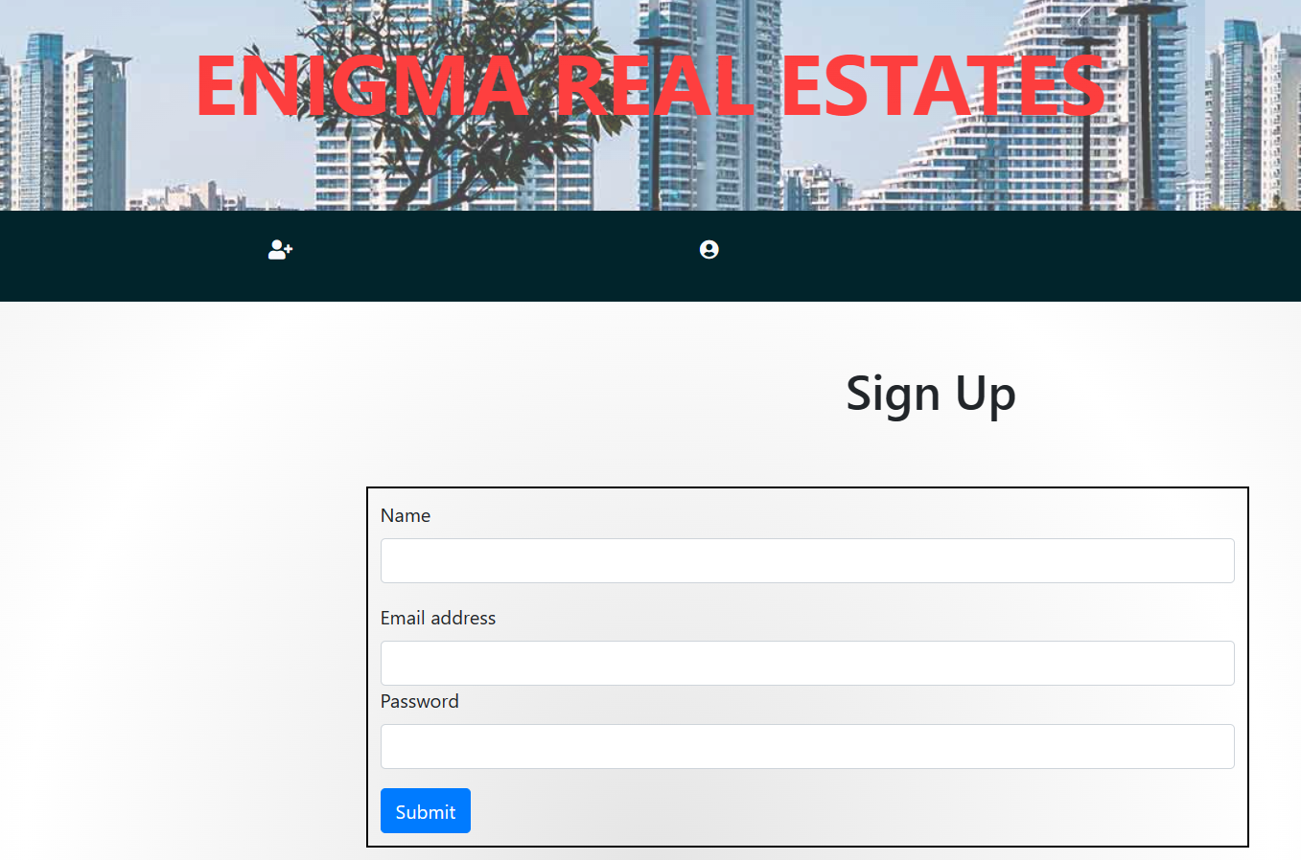
Sign-up page
If the user is new with us so he can create his account using our signup feature by adding his name , email and setting a new password.

Slide 5
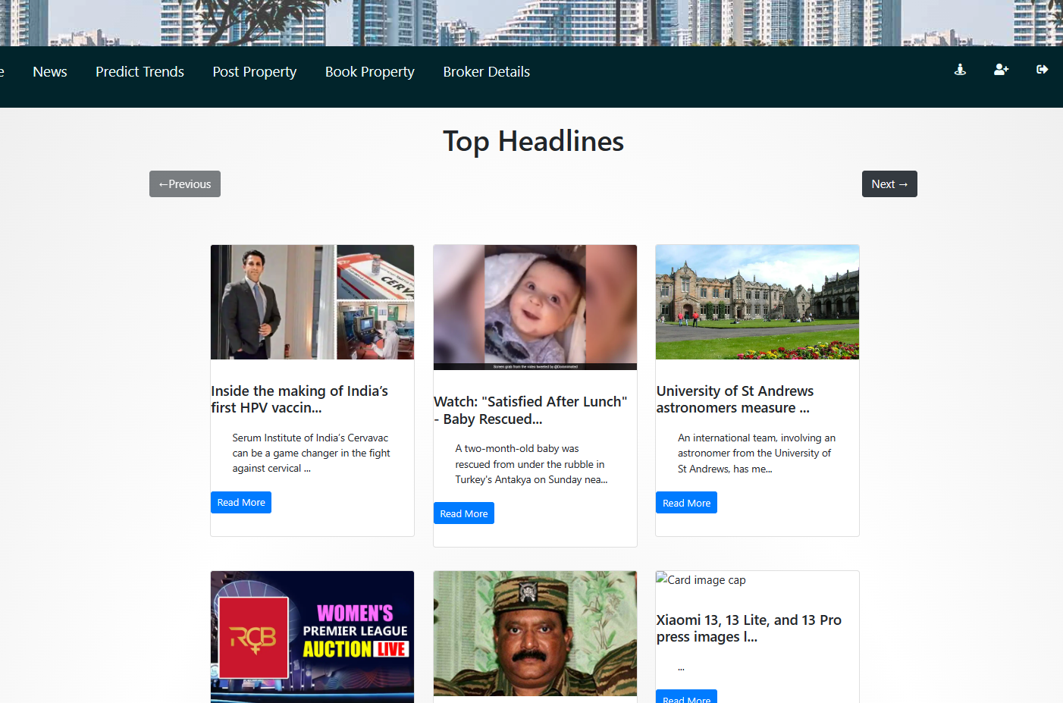
News page
In the news page the user can see the current trends and news regarding their search of real estate.

Slide 6
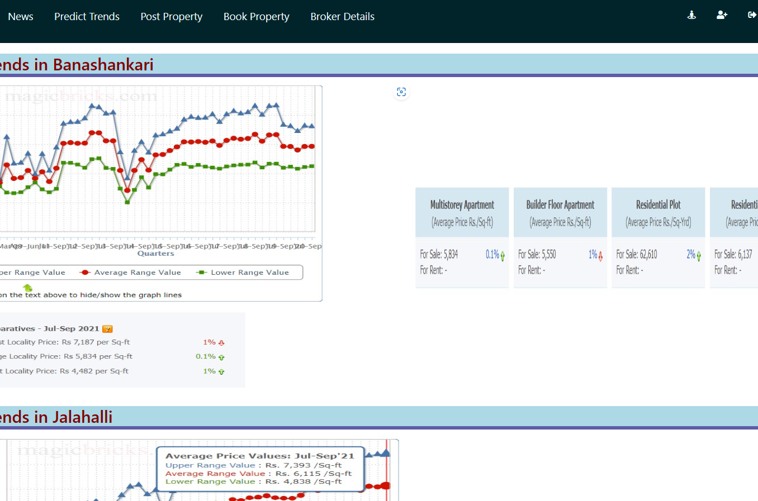
Trends page
The increasing and decreasing prices of property can be seen in trends page.

Slide 7
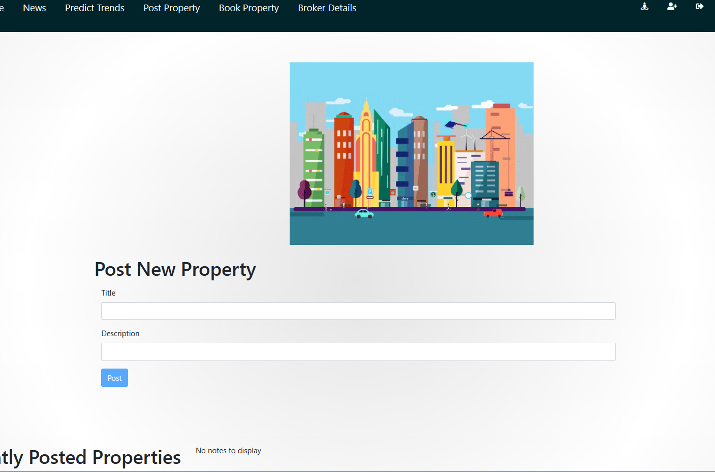
Post property
If you have property for sale, you can add it by adding a title and description.

Slide 8
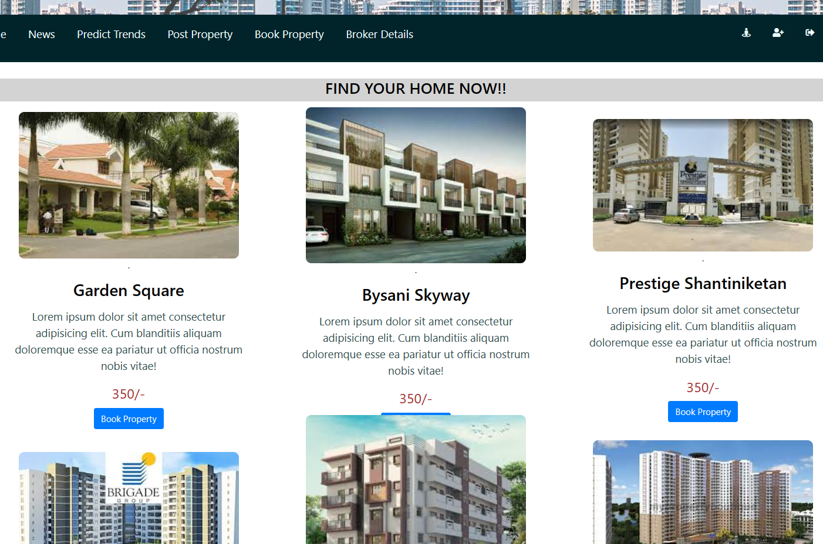
Book property
If you want to buy a property book it using book property feature.

Slide 9
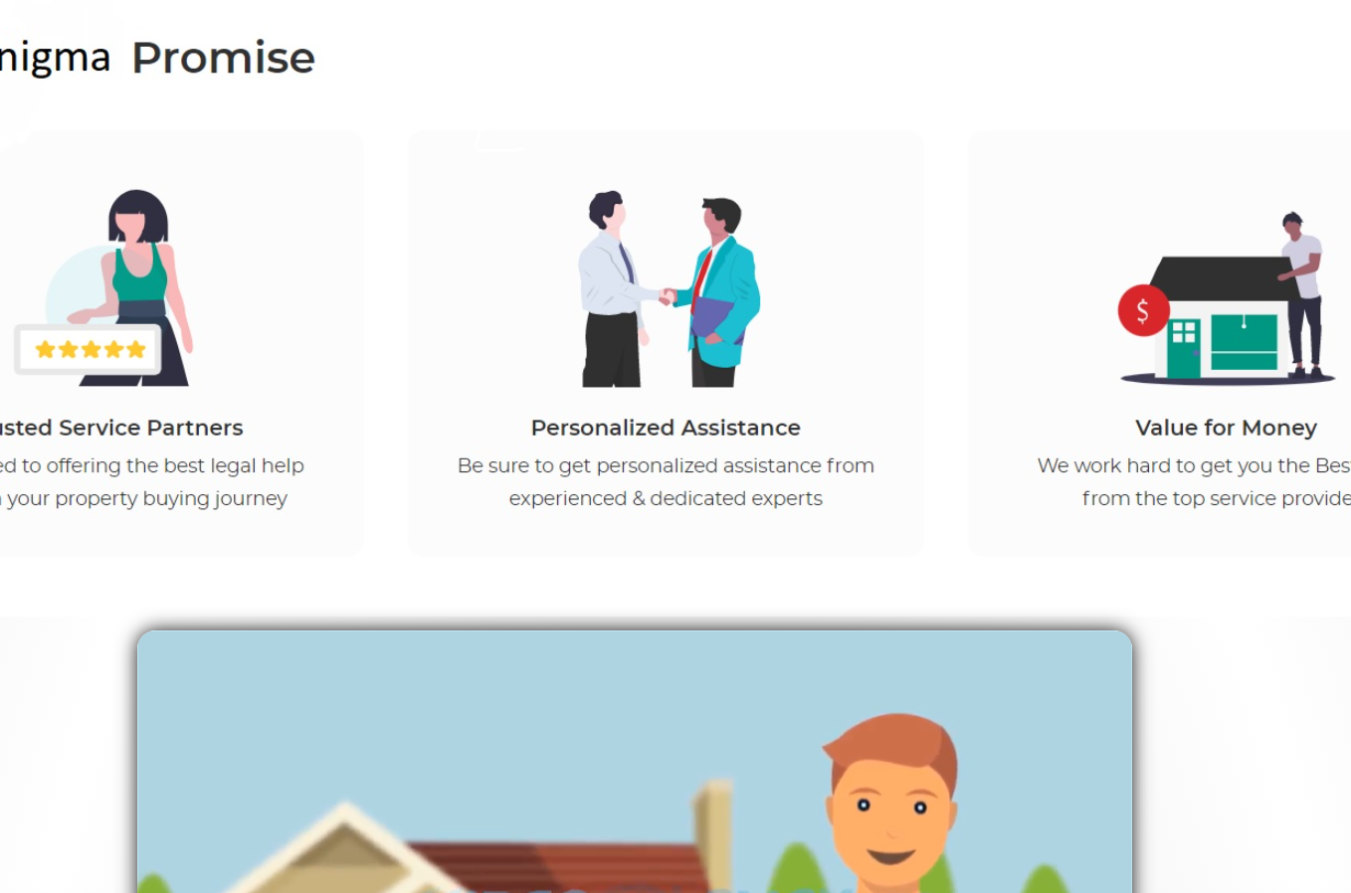
Broker details
Your brocker’s details will be available to you so have a safe and assured property dealing !

Slide 10

Thank you
Chirag Bansal
G-22
2010991525

